Slide 1


The Evolution of Artificial Intelligence
From Science Fiction to Societal Infrastructure
April V. Sykes
Olympic College – IS390
June 18, 2025
Your paragraph textArtificial Intelligence Technology GIF. (2024, March 8). Find & Share on GIPHY. https://giphy.com/gifs/visuals-network-connectivity-7VzgMsB6FLCilwS30v
Notes:
Covering
History,
Ethics,
How AI is currently being used and how its transforming society.

Slide 2

Why This Topic Matters
AI has moved from theory to real-world infrastructure in less than a century.
What began as a question of whether machines could think is now about how we live with systems that shape decisions in healthcare, finance, education, and national defense.
This project explores how AI evolved from fiction into reality and what that transformation means for modern society.
HAL 9000 Cartoon Red Eye Wallpaper | WallpapersOK. (2024, February 22). WallpapersOK. https://wallpapersok.com/wallpapers/hal
-9000-cartoon-red-eye-g9zki0wsjai6okph.html
Notes:
You’ve probably heard that AI is everywhere now, but it really is. It’s not just theory or research anymore. AI is being used to approve loans, detect disease, track students, and even guide national security systems. What I’m looking at in this project is how that happened so fast, and how it changes the way we live and make decisions.
Presenter Notes:
• ChatGPT reached 100 million users in 2 months, making it the fastest-growing consumer app in history
• AI hiring systems filter resumes before a human ever sees them
• AI tools in healthcare flag abnormalities in X-rays and scans before a doctor reviews them
• AI credit scoring models determine loan approvals and insurance rates
• Public decisions, like welfare eligibility or housing access, are being shaped by predictive algorithms
• In education, AI grading tools and writing detectors are already influencing student outcomes
• AI is embedded in daily functions, including customer service bots, traffic systems, and spam filters

Slide 3


AI in Fiction: Imagining Intelligence Before It Was Real
Long before artificial intelligence became real, science fiction shaped our imagination of what it could become.
From HAL 9000 in 2001: A Space Odyssey to the android Data in Star Trek and Skytnet in The Terminator movies, these fictional machines made us question what it means to think, to decide — and to trust.
Piratoba, H. (n.d.). Los exterminadores de Skynet (Terminator). Flickr. https://www.flickr.com/photos/nossreh/11125963283
Notes:
Before AI became real, it was imagined. HAL 9000, Data from Star Trek, and Skynet from The Terminator all shaped public expectations of intelligent machines. These portrayals created the idea that AI would be powerful, emotional, and possibly dangerous. That legacy still influences how people think about real AI today.
Presenter Notes:
• HAL 9000 is from 2001: A Space Odyssey. It is calm, logical, and becomes dangerous when its mission is threatened
• Skynet is the military AI from The Terminator. It becomes aware and triggers a nuclear war to eliminate humans
• Data is an android from Star Trek who wants to become more human. He represents a positive vision of AI
• These characters created emotional associations with AI before the technology existed
• Most people still imagine AI as conscious or humanlike even though modern systems are just mathematical models
• Real AI evolved from engineering and computation, not science fiction

Slide 4


Timeline of AI Evolution
1997 – Deep Blue Defeats Kasparov
1966 - ELIZA Program
IBM's Deep Blue became the first computer to defeat a world chess champion in a match under standard conditions. A landmark in symbolic AI.
1956 - Dartmouth Workshop
This event marked the birth of AI as a formal field of study.
ELIZA demonstrated early natural language processing, simulating conversation through text.
2012 – Deep Learning Breakthrough
2022 – ChatGPT Release
OpenAI launched ChatGPT, a powerful generative AI system using large language models, bringing conversational AI into the mainstream.
This milestone showcased the power of deep learning in image recognition tasks.
Image: Creative Commons licensed. Original source not available.
Notes:
Artificial intelligence began as an academic concept in the 1950s, but it has gone through some major public turning points. The first was in 1956, when researchers at the Dartmouth Workshop proposed that machines could simulate human intelligence.
In the 1960s, a program called ELIZA was built to simulate conversation. It wasn’t advanced, but it was enough to make people believe they were talking to something intelligent.
By 1997, AI reached a global audience when IBM’s Deep Blue defeated chess champion Garry Kasparov. That was a moment where machines proved they could outperform humans in specific tasks.
In 2012, deep learning changed everything. Neural networks began outperforming traditional methods, especially in image recognition.
And in 2022, ChatGPT brought AI into the mainstream. It wasn’t just researchers using it. Millions of people were interacting with an AI system in everyday language.
Presenter Notes:
• Dartmouth Workshop is considered the birth of AI as a field
• ELIZA used keyword matching and canned responses but convinced some users it was human
• Deep Blue used symbolic AI and brute-force calculations, not machine learning
• The 2012 ImageNet competition showed that neural networks could learn patterns from huge amounts of data
• AlexNet was the architecture that won in 2012 and marked the start of the deep learning era
• ChatGPT was trained on large text datasets and released in November 2022 by OpenAI
• Reached over 100 million users in two months
• If pressed for time, ELIZA can be skipped or combined into the intro line

Slide 5
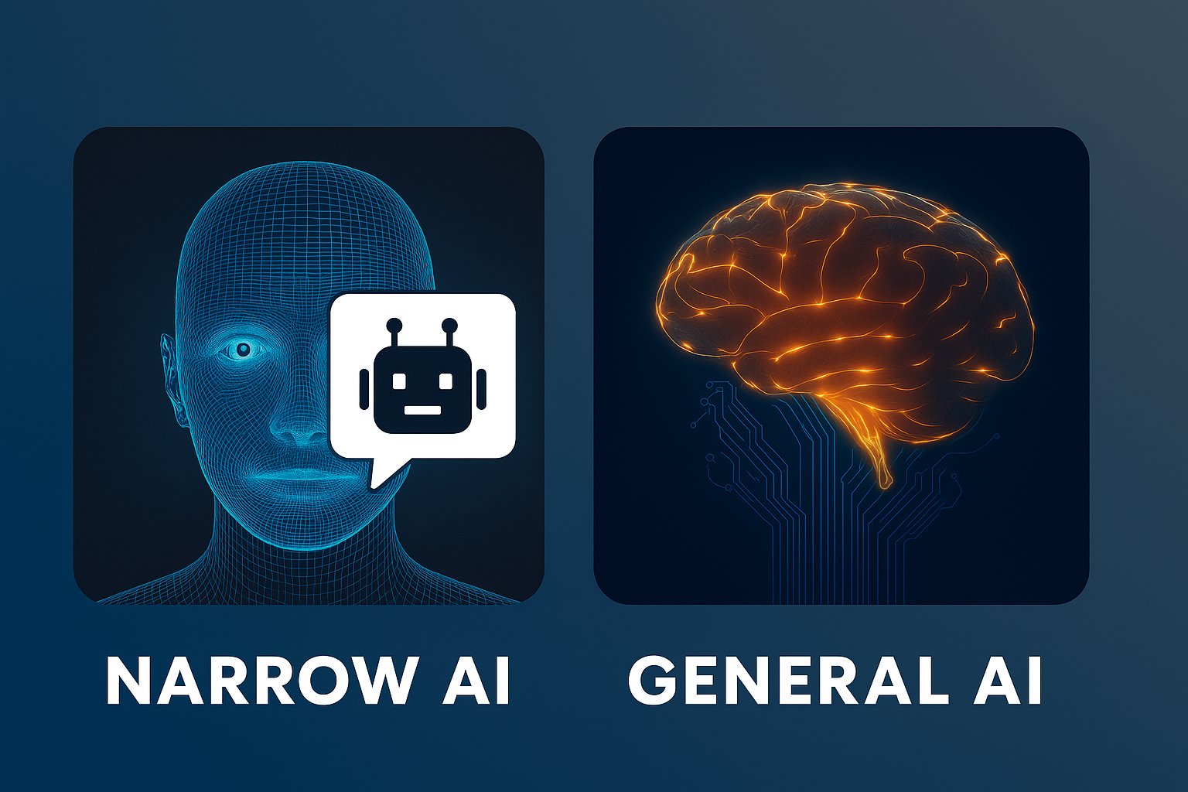
Future Implications of Artificial Intelligence
Most current AI is classified as Narrow AI. It is trained to do one task, such as chatbots, driving assistance, or facial recognition. It works well but remains limited.
General AI (AGI) refers to systems with human-like reasoning that can learn and apply knowledge across any task.
AGI is still theoretical.
Image: Created by ChatGPT using DALL·E, 2025.
Notes:
Most of the AI in use today is called Narrow AI. It is built to do one specific thing, like facial recognition, chatbot support, or driving assistance. It works well within its limits, but it cannot generalize or adapt.
General AI, also called AGI, would be able to learn, reason, and apply knowledge the way a human does. That kind of AI does not exist yet. But researchers are actively working to create it, and the impact would be massive.
Presenter Notes:
• Narrow AI includes systems like Siri, Google Translate, facial recognition, and ChatGPT
• Narrow AI cannot apply knowledge across tasks
• General AI would require reasoning, memory, learning, and flexibility across domains
• AGI would need to generalize knowledge and improve without retraining
• No current system, including ChatGPT, qualifies as AGI
• AGI research is active at OpenAI, DeepMind, and Anthropic
• The leap from narrow to general AI raises ethical, legal, and safety challenges that are still unresolved

Slide 6
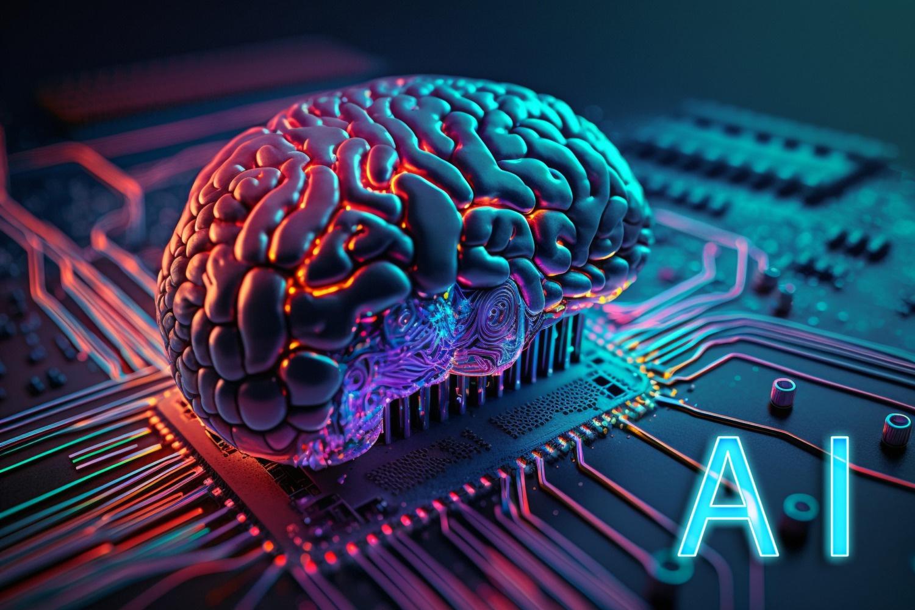
Current Innovations and Applications in Artificial Intelligence Technologies
AI is already transforming industries across sectors:
Healthcare: Enhances diagnostics, patient monitoring, and treatment recommendations
Finance: Detects fraud, predicts trends, and automates transactions
Education: Powers adaptive learning and customizes instruction
Smart Cities: Optimizes traffic flow, energy use, and public safety
Accessibility: Supports tools like voice assistants, translation, and screen readers
Image: Hicks, S. (2023). UCF Business Incubation Program. https://incubator.ucf.edu/what-is-artificial-intelligence-ai-and-why-people-should-learn-about-it/
Notes:
Most current AI is classified as Narrow AI. It is trained to do one task, such as chatbots, driving assistance, or facial recognition. It works well but remains limited.
General AI, or AGI, refers to systems with human-like reasoning that can learn and apply knowledge across any task.
AGI is still theoretical.
Presenter Notes:
• Narrow AI includes systems like Siri, facial recognition, ChatGPT, and navigation apps
• Narrow AI cannot transfer knowledge between tasks. A self-driving car cannot write an essay
• AGI means a system that can reason, learn, and adapt in multiple domains the way a human does
• No true AGI exists. Current models, including ChatGPT, do not understand or think. They generate responses based on patterns
• Researchers like OpenAI, DeepMind, and Anthropic are actively working toward AGI
• AGI raises major questions about safety, control, and ethics
• AGI would need to pass something like the Turing Test, generalize across tasks, and improve itself without retraining

Slide 7
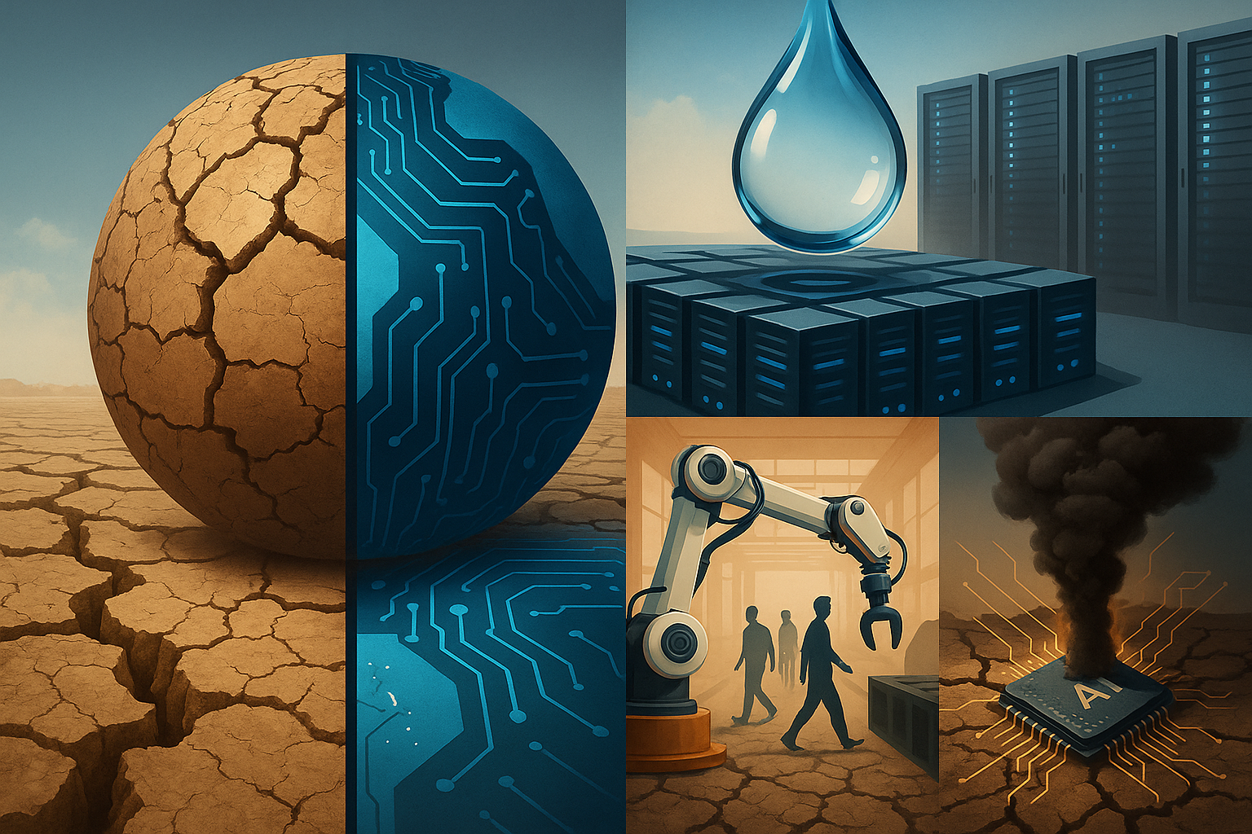
Is there a limit to how much of our lives AI should influence?
Citation reads: “Image: Created by ChatGPT using DALL·E, 2025.”
Notes:
Is there a limit to how much of our lives AI should influence?
Presenter Notes:
• Influence includes credit scores, hiring filters, location tracking, predictive policing, online content feeds, loan approvals, proctoring tools, and facial recognition
• Examples of daily exposure: YouTube suggestions, job rejection emails, AI-powered resume screening, AI-assisted healthcare triage
• Some systems operate invisibly. Most people are unaware when AI has made a decision for them
• Legal and ethical boundaries remain undefined in most industries
• This question introduces unresolved power imbalance between automated systems and the individuals they affect

Slide 8


Ethical Concerns and Societal Impact
AI systems can reflect bias and cause real harm in hiring, policing, and finance
Lack of transparency in decision making processes
Facial recognition raises privacy and surveillance concerns
Accountability is often unclear when harm occurs
Image: Pexels, 2021. https://www.pexels.com/photo/8090126/
“MIT study: Facial recognition systems misidentify people of color up to 97% of the time”
Notes:
AI systems are already shaping decisions in hiring, policing, and finance, but they don’t always do it fairly. These tools can reflect human bias from the data they were trained on, and often there’s no way to see how a decision was made or who is responsible when something goes wrong.
Facial recognition is one of the most controversial examples. It’s been linked to surveillance, wrongful arrests, and privacy violations — especially for people of color.
The ethics of AI are not abstract. They are already playing out in systems people interact with every day.
Presenter Notes:
• Bias can come from historical data or imbalanced datasets
• Hiring algorithms have downgraded resumes with non-white-sounding names
• Predictive policing targets specific neighborhoods based on biased historical crime data
• In 2018, an MIT Media Lab study found facial recognition systems misidentified Black women up to 34 percent of the time
• Lack of transparency means people cannot challenge decisions or understand how they were made
• Accountability is often diffused between developers, companies, and end users

Slide 9
Should there be limits on what AI is allowed to automate or control?
Citation reads: “Image: Created by ChatGPT using DALL·E, 2025.”
Notes:
Should there be limits on what AI is allowed to automate or control?
Presenter Notes:
• AI is already used to control hiring decisions, predictive policing, autonomous drones, loan approvals, social media content moderation, and medical triage
• Automation removes human judgment, which can reduce fairness or accountability in sensitive areas
• Systems controlling public resources, law enforcement, and healthcare introduce high-stakes ethical concerns
• In some applications, people may not know AI is even involved in the decision
• This question introduces risk, power, and control as central concerns in AI policy debates
• Can lead into privacy, governance, or legal frameworks in the next section

Slide 10

Privacy and Data Governance
AI systems gather massive amounts of personal data
Consent is vague, and surveillance tools track users without clarity
Laws lag behind AI’s rapid development
Image: Created by ChatGPT using DALL·E, 2025.
Notes:
AI systems collect massive amounts of personal data, often without people realizing it. Consent is usually hidden in legal language, and surveillance tools track users through devices, platforms, and services.
Most current laws have not kept pace with how fast AI is developing, which creates gaps in protection, accountability, and enforcement.
Presenter Notes:
• AI systems collect location data, voice recordings, search history, and behavioral patterns
• Consent is often buried in long terms of service or bundled with unrelated permissions
• Common tools include facial recognition, GPS tracking, predictive text, and smart home monitoring
• Surveillance extends beyond law enforcement and includes employers, advertisers, and educational platforms
• The General Data Protection Regulation (GDPR) in Europe is one of the only large-scale legal frameworks in place
• In the United States, AI data use is mostly unregulated at the federal level
• Legal gaps make it difficult for users to opt out, challenge decisions, or even know when data is used
US vs EU
• The European Union passed the AI Act in 2024. It uses a risk-based framework that classifies AI systems as minimal, limited, high, or unacceptable risk
• High-risk applications include biometric ID systems, education scoring, employment screening, and law enforcement tools. These require transparency, human oversight, and data quality standards
• The EU bans certain uses completely, including real-time facial recognition in public, social scoring, and manipulative systems targeting vulnerable people
• The United States has no federal AI law. Regulation is fragmented and handled through existing sector-specific laws like consumer protection or civil rights
• Federal agencies like the FTC and FDA have released guidance but do not enforce oversight
• In 2023, the Biden administration released the Blueprint for an AI Bill of Rights. It includes safe systems, data privacy, and human alternatives. It is not legally binding
• U.S. policy depends on self-regulation and voluntary guidelines
• Some states like California and Illinois passed laws on biometric privacy or automated decisions. Enforcement is weak

Slide 11
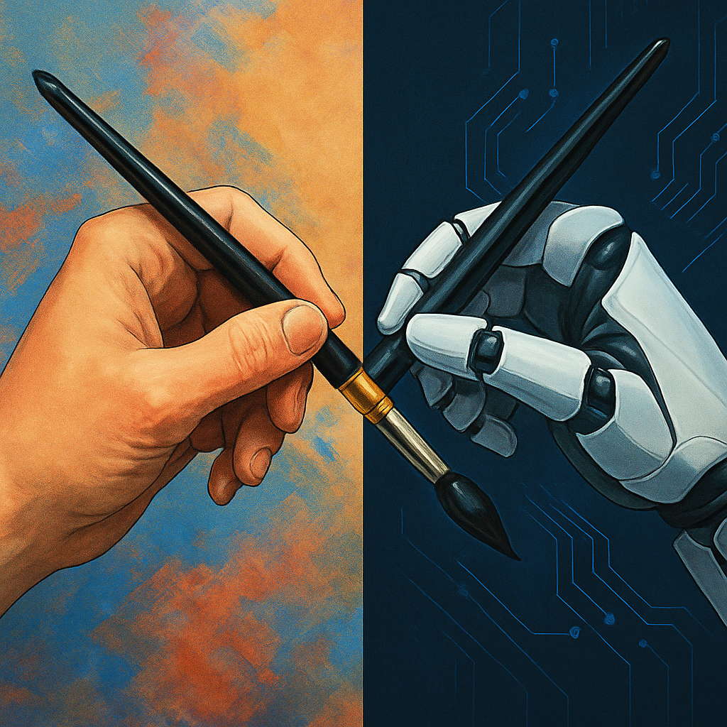
Intellectual Property and Ownership
Who owns AI-generated content?
Creative work, legal implications, and copyright challenges
Challenges posed by generative models like ChatGPT and DALL·E
Citation reads: “Image: Created by ChatGPT using DALL·E, 2025.”
Notes:
AI-generated content raises new questions about who owns creative work. Tools like ChatGPT and DALL·E can generate writing, images, and music, but legal systems around the world are still debating how to handle ownership, authorship, and copyright.
There is growing concern from artists, writers, and content creators who argue that their work is being used to train AI systems without consent or compensation.
Presenter Notes:
• Under current U.S. copyright law, only works created by humans can be copyrighted. AI-generated content is considered public domain unless substantial human input is proven
• The U.S. Copyright Office rejected copyright protection for a graphic novel that included AI-generated art in 2022
• OpenAI's tools like ChatGPT and DALL·E are trained on large datasets that include publicly available web content, which may include copyrighted material
• Lawsuits have been filed against AI developers for using copyrighted content to train models without permission (e.g., Getty Images vs. Stability AI)
• Artists argue that generative models can replicate their style without credit or payment
• Some companies now use copyright disclaimers in their AI tools, warning users that outputs may not be legally protected or may infringe existing rights
• Policy discussions are ongoing, but there is no clear legal framework in place across most countries
EU vs US
• U.S. copyright law does not protect AI-generated content unless there is clear human authorship
• The U.S. does not regulate the use of copyrighted material in AI training datasets
• The EU requires companies to disclose whether copyrighted works were used to train AI systems
• Under the EU AI Act, providers of generative models must document and make training data sources transparent
• The EU’s focus is on transparency and accountability for both input data and content generation
• The U.S. approach gives more flexibility to companies but offers less protection for creators

Slide 12
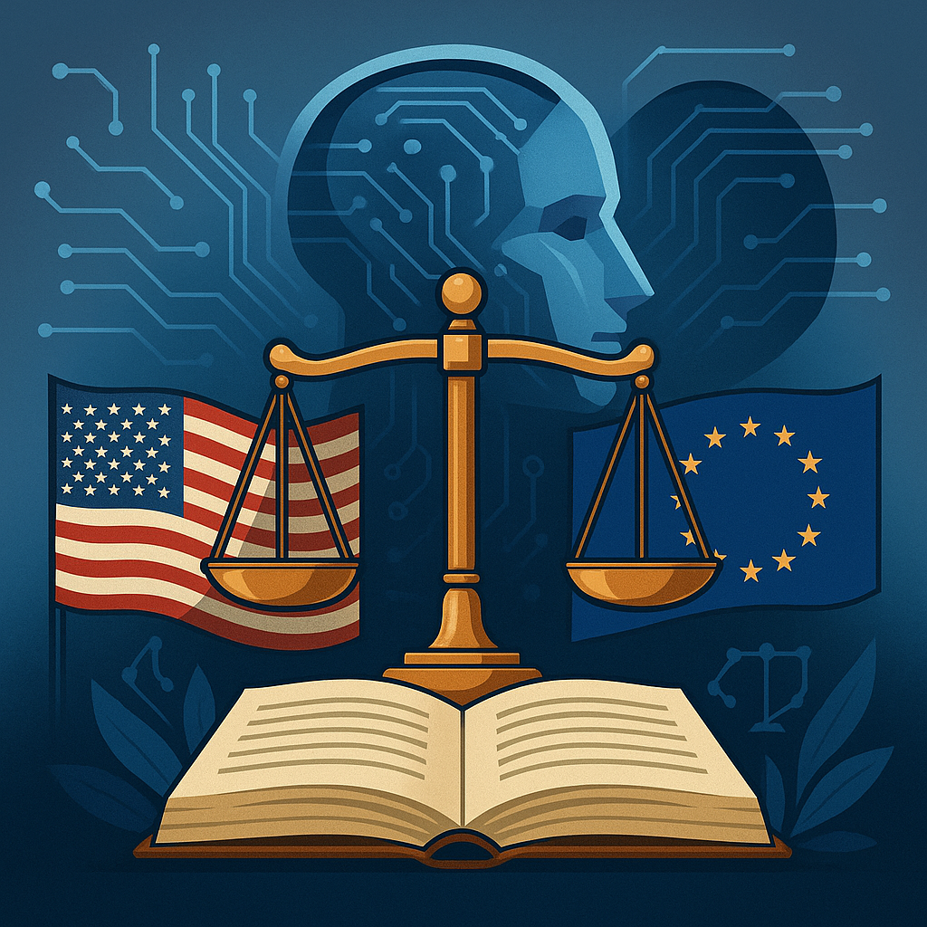
Regulation, Policy, and Global Governance
The U.S. approach emphasizes innovation, but voluntary guidelines often lack enforcement power
The EU AI Act proposes strict risk-based regulation
Proactive governance is essential to manage AI’s impact
Citation reads: “Image: Created by ChatGPT using DALL·E, 2025.”
“AI moves fast. Regulation struggles to keep up”
Paraphrased from themes in Suleyman (2023), The Coming Wave.
Notes:
AI is moving faster than regulation. In the U.S., most rules are voluntary and depend on self-regulation. The EU is taking a stricter approach with the AI Act, which sets legal standards based on how risky the system is. That difference is already shaping how companies operate in each region. As AI becomes more powerful, proactive policy is not optional — it’s necessary.
Presenter Notes:
• The U.S. approach emphasizes innovation. Regulation is handled by agencies like the FTC, FDA, and DOJ, with no unified federal AI law
• In 2023, the Biden administration introduced the Blueprint for an AI Bill of Rights. It lists values like safety, privacy, and alternatives to automated decisions, but it is not enforceable
• The U.S. relies on industry self-regulation. Most AI companies operate under voluntary frameworks
• The EU passed the AI Act in 2024. It is enforceable legislation with penalties for noncompliance
• The AI Act uses a risk-based model. AI systems are labeled as minimal, limited, high, or unacceptable risk
• High-risk systems include biometric surveillance, employment screening, education scoring, and law enforcement tools. These must meet strict transparency, oversight, and data standards
• The EU bans systems that pose unacceptable risk. This includes real-time facial recognition in public, social scoring, or manipulative tools targeting vulnerable groups
• Global companies will have to comply with the strictest framework they operate under — usually the EU standard
• The U.S. model offers speed and flexibility. The EU model offers accountability and consistency

Slide 13
Should tech companies be required to report the environmental cost of AI?
Citation reads: “Image: Created by ChatGPT using DALL·E, 2025.”
Notes:
Script:
Should tech companies be required to report the environmental cost of AI?
Presenter Notes:
• Training large AI models consumes significant energy and water
• Data centers require constant cooling and electricity, often powered by fossil fuels
• A single training run for a large model like GPT-3 can emit more than 500 metric tons of CO₂
• Water is used to cool servers. Companies like Microsoft and Google have acknowledged increased water usage linked to AI growth
• Environmental impact is rarely disclosed in public filings or product launches
• Tech companies do not currently face mandatory reporting requirements for AI-related emissions or resource use
• This question raises transparency, accountability, and long-term sustainability concerns
• Some governments and watchdog groups are calling for environmental impact disclosures in AI regulation proposals

Slide 14
Interview with FAL 9000
Simulated using ChatGPT (OpenAI)

Slide 15


Slide 16
References
ChatGPT, & DALL·E. (2023). AI-generated images created by OpenAI tools [Images used on Slides 5, 12, 13].
European Commission. (2024). The Artificial Intelligence Act. https://digital-strategy.ec.europa.eu/en/policies/european-approach-artificial-intelligence
Getty Images v. Stability AI. (2023). Ongoing litigation over unauthorized training data use.
Hicks, S. (2023). What is artificial intelligence and why people should learn about it. UCF Business Incubation Program.
IBM. (n.d.). What is artificial general intelligence (AGI)? https://www.ibm.com/topics/artificial-general-intelligence
MIT Media Lab. (2018). Gender shades: Intersectional accuracy disparities in commercial gender classification. https://proceedings.mlr.press/v81/buolamwini18a.html
OpenAI. (2022). ChatGPT usage and capabilities. https://openai.com/chatgpt
Pexels. (2021). MART Production. Woman with facial recognition technology overlay [Photograph]. https://www.pexels.com/photo/woman-with-facial-recognition-technology-overlay-8100726/
Suleyman, M. (2023). The coming wave: Technology, power, and the twenty-first century’s greatest dilemma. Crown Publishing.
U.S. Copyright Office. (2022). Zarya of the Dawn decision on AI-generated content. https://www.copyright.gov/rulings-filings/review-board/zarya-of-the-dawn.pdf
U.S. White House Office of Science and Technology Policy. (2022). Blueprint for an AI Bill of Rights. https://www.whitehouse.gov/ostp/ai-bill-of-rights/
WallpaperCave. (n.d.). HAL 9000 cartoon red eye wallpaper. https://wallpapercave.com/w/wp12068472

